Slide 1

Java Code Base Interview quesiton

Slide 2
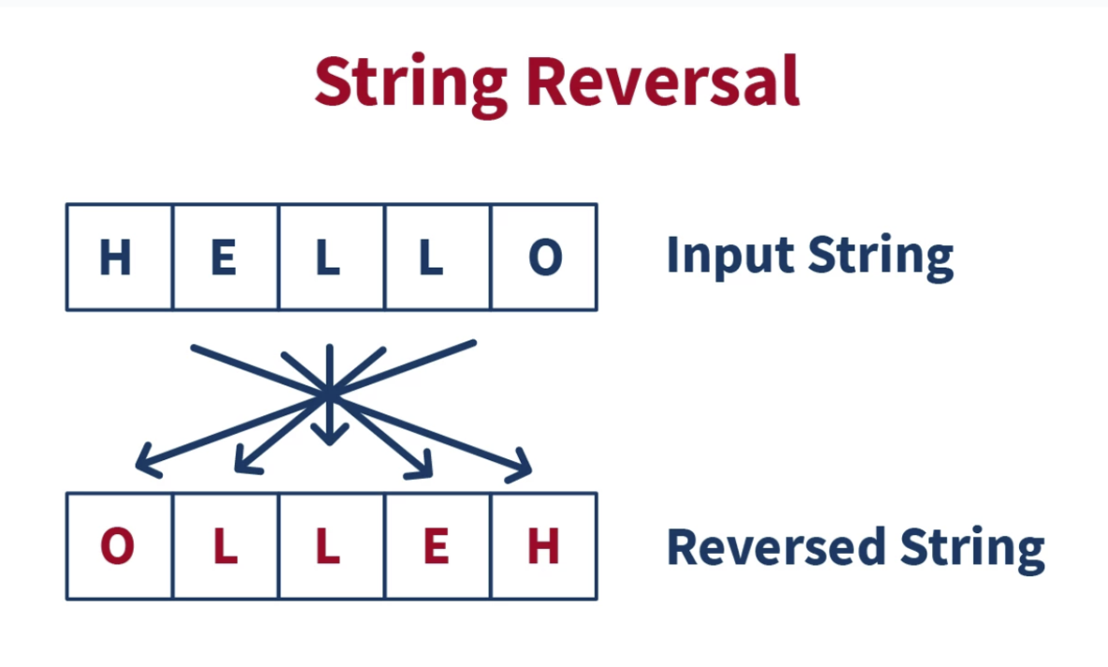
Reverse String
Different ways to reverse a string in Java.
1- By using toCharArray()
2- By using StringBuilder
3-By using For Loop
4-By using ArrayList objects
5-By using recursion

Slide 3
1- By using toCharArray()
public static String reverse(String str)
{
String rev="";
char[] finalarray = str.toCharArray();
for (int i = finalarray.length - 1; i >= 0; i--)
rev+=finalarray[i];
return rev;
}

Slide 4
2- By using StringBuilder
public static String reverse(String str)
{
StringBuilder obj = new StringBuilder();
//append is inbuilt method to append the data
obj.append(str);
obj.reverse();
return obj.toString();
}

Slide 5
3-By using For Loop
public static String reverse(String str)
{
String rev="";
int i=0;
int len=str.length();
for(i=len;i>0;i--)
{
rev+=str.charAt(i-1);
}
return rev;
}

Slide 6
Counting Character of String
String str = "Afghanistan is a beautiful country ";
int count = 0;
for (int i = 0; i < str.length(); i++) {
if (str.charAt(i) != ' ') {
count++;
}
}
System.out.println("The Total Charactor of String "+str +"is: " + count);

Slide 7
Count Specific Character in String
String str = "Afghanistan is beutifule country ";
int count = 0;
for (int i = 0; i < str.length(); i++) {
if (str.charAt(i) == 'a') {
count++;
}
}
System.out.println(" Occurrences of character 'A' in string is: " +count);

Slide 8
Eliminating Character from String
Eliminating the first and last character from String and print.
String str="kamal";
String substring = str.substring(1, str.length() -1);
System.out.println(substring);

Slide 9
Finding the middle character from given String
String str = "CodeWithKamal";
int len = str.length();
System.out.println(len);
int middle = len / 2;
System.out.println(str.charAt(middle));

Slide 10
Output of the program
public class MethodPractice {
public static void main(String[] args) {
System.out.println(Adder.add(11,11));
}
static int add(int a, int b) {
return a + b;
}
static double add(int a, int b) {
return a + b;
}
}

Slide 11
Remove Duplicate from Array
ArrayList<String> list = new ArrayList<String>();
list.add("Kamal");
list.add("Jan");
list.add("Kareem");
list.add("Kamal");
Set<String> set = new HashSet<String>(list);
System.out.println(set);

Slide 12
Remove integer form String
String str1="kamal KHAN1234rr44tt66yy778";
String num = str1.replaceAll("[^0-9]", "");
System.out.println(num);

Slide 13
Swapping two Numbers
Swapping two number without third variables
int num1=40;
int num2=50;
num1=num1-num2;//-10
num2=num1+num2;//40
num1=num2-num1;//50
System.out.println(" NUM1 vALUE AFTE SWAP :" +num1);
System.out.println(" Num2 Value after swap "+num2);

Slide 14
Count of Capital and Small letter in String.
String str = "CodeWithKamal232343243$#%^#@ Learn @ the !@ Easy %&*$";
int upperCase = 0, lowerCase = 0, number = 0, specialsymbol = 0;
for (int i = 0; i < str.length(); i++) {
char ch = str.charAt(i);
if (ch >= 'A' && ch <= 'Z') {
upperCase++;
} else if (ch >= 'a' && ch <= 'z') {
lowerCase++;
} else if (ch >= '0' && ch <= '9') {
number++;
} else
specialsymbol++;
}
System.out.println("Count of Upper Case is " + upperCase);
System.out.println("Count of Lower Case is " + lowerCase);
System.out.println("Count of number is " + number);
System.out.println("Count of Symbol is " + specialsymbol);

Slide 15

String Palindrome
A string is said to be palindrome if it reads the same backward as forward. For e.g. above string is a palindrome because if we try to read it from backward, it is same as forward. One of the approach to check this is iterate through the string till middle of string and compare a character from back and forth.

Slide 16
String Palindrome cont…..
String reverse = "";
String original = "bob";
for (int i = original.length() - 1; i >= 0; i--) {
reverse += original.charAt(i);
}
System.out.println(reverse);
if (reverse.equals(original))
System.out.println("String is Palindrome!");
else
System.out.println(" String Is Not Palindrome!");

Slide 17
Remove Duplicate character from String.
String string = "aabbccdefatafaz";
char[] chars = string.toCharArray();
Set<Character> charSet = new LinkedHashSet<Character>();
for(int i=0; i<chars.length; i++) {
charSet.add(chars[i]);
}
StringBuilder sb = new StringBuilder();
for (Character character : charSet) {
sb.append(character);
}
System.out.println(sb.toString());
}

